Slide 1
Week05 Solution
Stacey Wang

Slide 2
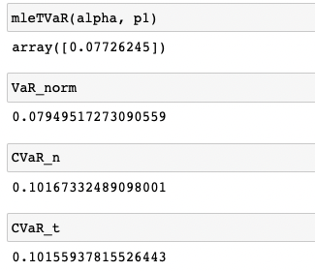
Problem 1
Value at Risk (VaR) is the negative of the predicted distribution quantile at the selected probability level.
Expected Shortfall (ES) is the negative of the expected value of the tail beyond the VaR
Under situation when the distribution of a certain portfolio is skewed or has multiple peaks, even though VaR is the same, ES could indicate the potential risk of the portfolio better by showing potential loss/gain than Value at Risk

Slide 3
Problem 2
See portfolio in the following link:
https://github.com/zw219/FinTech590-RiskManagement.git

Slide 4
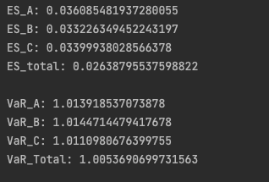
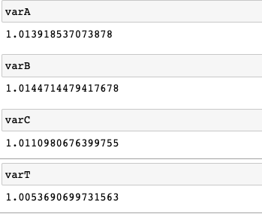
Problem 3
Using repo from #2:
Results from Week04-P3:

